Slide 1




We are losing freedom in the enterprise
by Dr. Rodolfo Luthe, Ph. D.

Slide 2



There is a contradiction in the free enterprise
In our country we have experienced a management history with a relative freedom, which is the cause limiting its free growth.

Slide 3

Government attacks the enterprise
In the 70’s the President Luis Echeverria-Alvarez attacked the management sector declaring to the mass media that the poverty in Mexico is due to the excessive economic businessmen ambition.

Slide 4
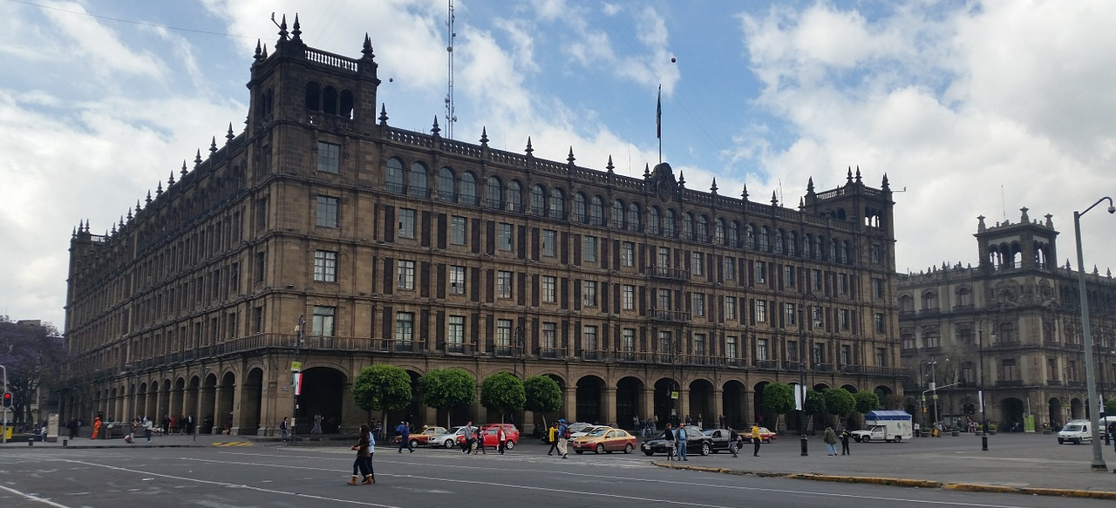
Government generates government-enterprises
President Luis-Echeverria started the generation of government-enterprises, with the concept of creating wealth to be equally distributed among the company workers.

Slide 5

The oil boom makes us a rich country
The next President, Jose Lopez-Portillo, experienced the oil boom and the growth of government-enterprises, to a total of 1,400. The political corruption reached an alarminng national and level.

Slide 6
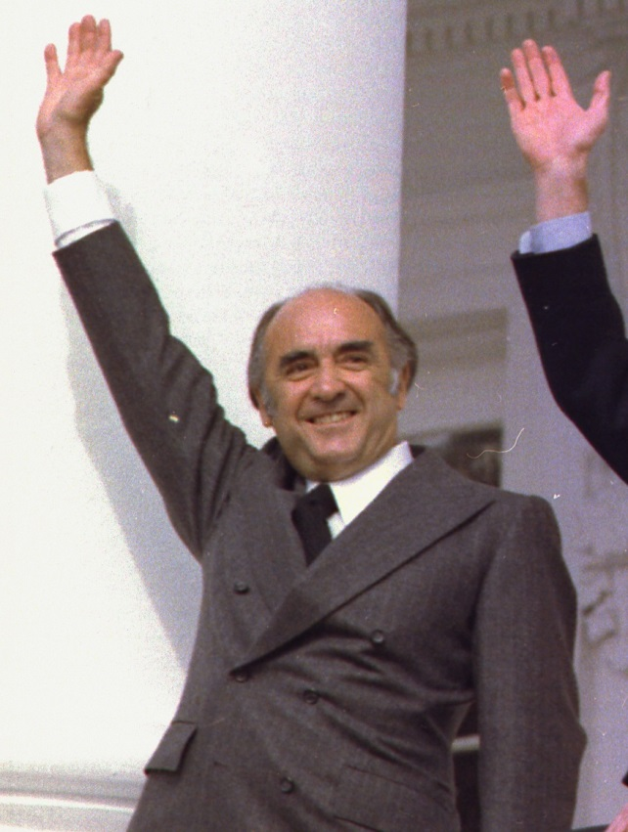
President José López-Portillo visits IPADE
During his stay at IPADE we listened his speech and in the question and answer part, a manager leader asked him about the corruption image of the political sector. The President said that he was aware of this corruption, but commented that there are honest public officials, who are approached by managers, bribery, and are invited to corruption. Everybody was quiet, thinking what he said, and corruption was 50% for each sector.

Slide 7
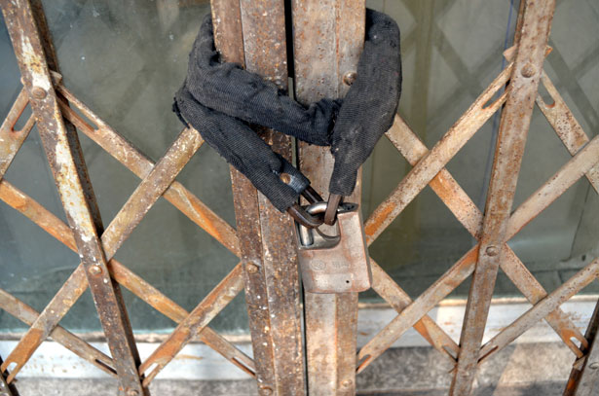
The government-enterprise is not sustainable
Government-enterprises are not sustainable because they are not profitable, even if they care for the person and the environment. Next President, Miguel de la Madrid, sold and colsed all 1,400 government-enterprises.

Slide 8

The government-enterprise is not sustainable, world wide
Israel is an interesting case because at the beginning government did not trust private companies. They generate government-enterprises and after several years they had poor economic results. They decided for a government and business alliance, with transparent rules for each side. Today Israel is a first world country.

Slide 9

The XXI Century Enterprise is a new paradigm
The Wisdom Board Foundation has developed a new paradigm: The XXI Century Enterprise, a sustainable ZERO corruption organization. It is based in the neural networks research, using Einstein’s science.

Slide 10

Internationalization process
One internationalization example is Brazil’s Amazonia, proposed as a universal patrimony to keep the oxygen produced for the world’s benefit. The internationalization process helps in analyzing oil, capital, health, etc.

Slide 11

Mexico, spark for all the world
The internationalization process allows us to solve more than twenty challenges and Mexico may be the spark for the solution of these challenges, world wide.

