Slide 1


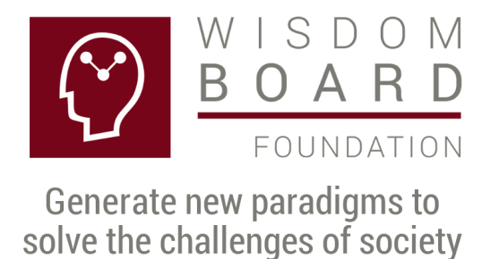

Process manual: The XXI Century Enterprise Caring for the person
Rodolfo Luthe, Researcher, Ph. D.

Slide 2


Introduction
Caring for the person is a very important subject in the XXI Century Enterprise project, a ZERO corruption organization. Also, the challenges in our society can be solved, succeeding in the vision: We want to live in a first world country, with a dignified quality of life for everybody.
The required condition in caring for the person is the Top Management commitment in advancing towards the XXI Century Enterprise vision, looking for the human being happiness, developing and harmonizing spirit, mind and body.
The mission considers the society challenges, giving them a solution and executing a plan to solve them, because the enterprise has the capacity to solve successfully such threats.

Slide 3
Personal Attention Volunteer, PAV
The XXI Century Enterprise invites all the collaborators to become Personal Attention Volunteers, PAV, helping any person who seeks them.
The Personal Attention Volunteer, PAV, is a person with a special training to satisfy this job, which is important in order to improve the organization´s environment, considering the vision to look after the happiness of the human being.
The personal attention is the basis in order to improve the organization’s environment, taking advantage of the high technological platform available in the Bioener company.

Slide 4
Harmonizing spirit, mind and body
The Personal Attention Volunteer has the opportunity to pursue his attention network, growing and harmonizing the spirit, mind and body of all the persons in his data base.
The human being is formed with spirit, mind and body. Integral happiness and integral health consider the spirit, mind and body, looking to harmonize and balance them.
The objective of the Personal Attention Volunteer is to find integral happiness and health in the collaborators of the XXI Century Firm.

Slide 5
ZERO corruption organization
The person interested in living the integral happiness and health project is a ZERO corruption person.
The reason is that happiness and health are contradictory concepts with the corruption definition. Corruption does not generate happiness and health, although it is not easy to detect.
The explanation is that nature does not forgive and corruption is against the natural law.
The ZERO corruption organization is the result of the integration of all the collaborators, being each one a ZERO corruption person.

Slide 6
The family of the Personal Attention Volunteer
The activity of the Personal Attention Volunteer looking for the integral happiness and health of the other persons will give him very valuable experiences and all these testimonies will be a reference to invite members of his own family to participate in the project.
All the collaborators who received the benefit of the caring for the person concept will do the same with their own families, inviting them to receive the same benefits.
In this way the chain of value is stronger in Person, Family and Company. We can start with the firm and later with the family and the person.

Slide 7
Neuronal networks: a new paradigm
The neural networks research allows us to present a new paradigm, understanding in a better approach the human being operation, as well as the interactions among different persons.
The postulate is: If your Neural Networks are fine, ALL is fine.
If we consider the human being composed of spirit, mind and body, then any disequilibrium or indisposition indicates an electric disequilibrium of one or many neural networks.
The research allowing us to find the ZERO corruption person, looking for his integral happiness and health, is based in Einstein’s science.
The neural networks are a solution because they have a distinctive characteristic allowing for the growth of the person’s intellectual capacity.

Slide 8
Attention Center, AC
The attention Center, AT, is an organization which centralizes the Personal Attention Volunteer, PAV, information.
The Personal Attention Volunteer has his own data base, helping him to give the best service to the persons registered in such data base. He sends information to the Attention Center in order to solve the person’s situation.
The Attention Center uses technological platforms with high technology in order to be able to satisfy the personal attention and the excellent service promised. The Attention Center has no limit in the number of available specialists to assist in the person, family and enterprise requirements.

Slide 9
Attention Center, AC
An Attention Center specialist deals confidentially a person’s situation, having the interested person an individual code to access his personal file.
The Personal Attention Volunteer has his own individual code with the general information of his data base, but without access to the specialist confidential information. We live the solidarity and subsidiarity concepts.
The Attention Center, AC, is the organization studying the information with an innovator multilevel research system, helping to develop new paradigms.

Slide 10
A country is sustainable only if the enterprises are sustainable
The only way to live in a sustainable country is if all the organizations are sustainable, specially the enterprises generating wealth.
To be sustainable implies caring for the person, the environment and the profit, considering the person, the family and the company.
The XXI Century Enterprise is a sustainable organization formed by sustainable families, with the family members being sustainable.
One conclusion is that a sustainable country needs all citizens to be sustainable.

Slide 11
Mexico, spark for all the world
The internationalization process is an opportunity allowing us to participate in value added project, because we have a solution to more than twenty world wide challenges
In our research we have developed the corresponding mathematical models, using high technology with the technological platforms available.
We have the opportunity to integrate all the interested persons, participating in collective neural networks oriented to solve the challenges under consideration, with the support of Einstein’s science.
There is a possibility that Mexico may be the spark for these challenges solution, world wide.

Slide 12
The action is THIS Club: I don’t want THIS in my country
The Club’s inscription is free and we are inviting you to the best experience: building a first world country. Information in www.fundacionjoven.org

